Slide 1
Creation and Validation of Define-XML 2.0 using Pinnacle 21 Enterprise
11 Sep 2017
Sam Tomioka

Slide 2
Agenda
Define-XML use cases
Define-XML creation process
Define-XML validation process

Slide 3
Define Designer use cases

Slide 4
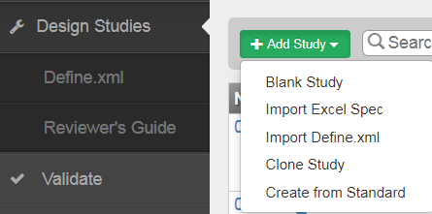
Sunovion’s Define Designer Use Cases - 1
Function | Use Case
Blank Study | Creation of standards (SDTM, ADaM, DTS), Study define file
Import Excel | Update of standards, study define file
Import Define | Validation of standards and study define Conversion of define v1 to v2, v1 to define.pdf Update define.xml
Clone Study*
Create from Standard | Creation of initial define file specifications (Prescriptive approach)
* Not used.

Slide 5
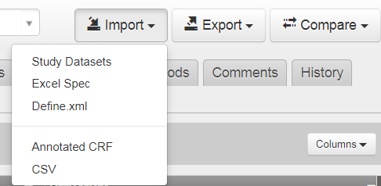
Sunovion’s Define Designer Use Cases - 2
Function | Use Case
Study Datasets | Populate metadata of SDTM or ADaM (descriptive approach)
Excel Spec | Import updated metadata (terminology, origin, method, comment etc.)
Define.xml | Validate define.xml from CRO, Produce define.pdf from define.xml v1
Annotated CRF | Populate CRF pages for SDTM Define
CSV | Add new variables, terminology, and methods*
* Tried but did not work well.

Slide 6
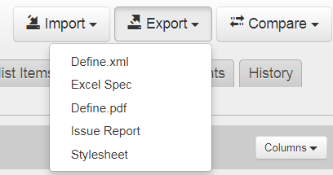
Sunovion’s Define Designer Use Cases - 3
Function | Use Case
Define.xml | Produce final define.xml for studies or standards
Excel Spec | Modify or update metadata, produce final spec
Define.pdf | Produce define.pdf from V1 define or for legacy studies.
Issue Report | Communication tool for CROs, need to combine with the report from ‘Validate’
Stylesheet*
* Not used.

Slide 7
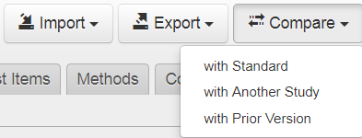
Sunovion’s Define Designer Use Cases - 4
Function | Use Case
With Standard | Validation against standards
With Another Study*
With Prior Version | Identify changes made by other users outside of the system
* Not used often

Slide 8
Define-XML creation process

Slide 9
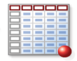

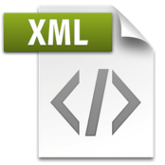

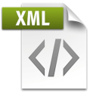

Descriptive approach
Import dataset metadata
Xpt files
Import page numbers
(SDTM only)
Define.xml
aCRF
Export/Import
Merge codelist
(SDTM only)
Rave ALS
Lots of data entry
Merge comments, method
Excel Spec
SDTM/ADaM specs
Notes:
Pain points:
1) Importing of additional codelist not found in the datasets. Then removal of duplicate codelist. eDiary, ePRO may not provide a xlsx file with complete codelist.
2) Specs do not have comment ID, method ID. SDTM specs structure varies by CROs. Merging comment/method need some SAS manipulation
3) Lots of back and forth between Comment/Variable , Comment/Value Level and Method/Variable if they are done manually

Slide 10
Few notes for creating define.xml:
Most of us used Excel Spec to add additional metadata. Easier to add Codelist Items/Method/Comment. In p21E GUI, Codelist ID/Method ID/Comment ID must be pre-populated.
Import CSV for variables, methods, and terminology may not work. These have been either manually entered to Excel Spec or programmatically populated outside of P21E.
For ADaM define.xml, we could choose either SDTM or ADaM CT for populating NCI codes for the codelist. We choose SDTM CT for ADaM define.xml because there are more SDTM CT terms compare to ADaM CT terms.
Domain attribute is not applicable for ADaM datasets so, manually removed Domain attribute after producing ADaM define.xml.

Slide 11
Define-XML validation approach

Slide 12
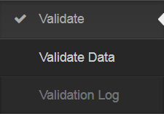
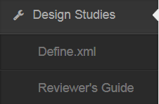
Define Validation Approach
Validate dataset only
Validate against standards using Define.xml – Design →Compare→With Standard
Validate through Validator
Validate Define.xml only
Validate through Validator
Validate through Designer
Validate dataset + Define.xml only →address issue
Validator
Files to be checked | Validator | Designer
Dataset | Y – against rules | Y – against standard¹
Define | Y – against rules | Y – against standard¹ , integrity check² , internal consistency etc. ³
Dataset + Define | Y – against rules, consistency between xpt and define
Designer
1 Define.xml – Design →Compare→With Standard
2 Define.xml may not be importable with integrity issues. Issues are displayed on Import window.
3 Issues reported in “Issue” tab
Notes:
Validate Dataset only
Validate against standards in Designer - Compare
Validate through Validator
Validate Define.xml only
Validate through Validator (sometime cannot load, need to fix with an editor
Validate through Designer (need to go back and forth between “Validation Log” and “Designer”
Load Define.xml to Designer → address issue
Validate Dataset +Define.xml only →address issue

Slide 13
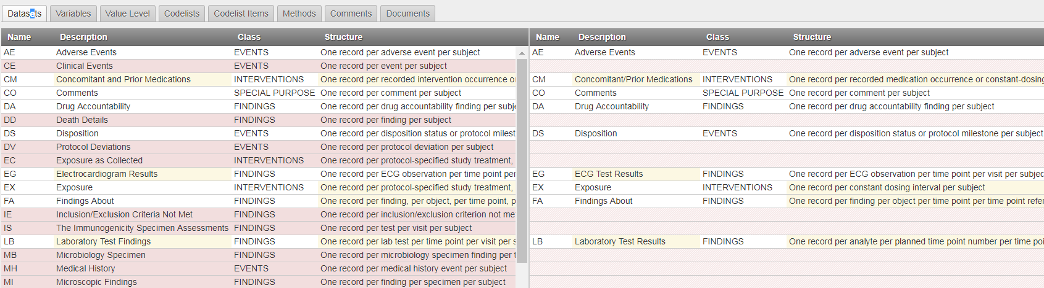
Validation against standards
DSP-SDTM Ver 4.0
Study Define.xml

Slide 14
Few notes for validation:
Recommended order to validate define.xml
Validate define.xml using Designer. Address issues
Validate define.xml using Validator. Address issues in Designer or Ultraedit
Validate define.xml with data using Validator
Recommended files to include when validating define.xml using Validator
Datasets in SAS Transport Version 5 (.XPT) format
PDF files e.g. acrf.pdf, adrg.pdf, csdrg.pdf referenced in define.xml
Stylesheet

Slide 15
Thank you for listening!
Sam.Tomioka@Sunovion.com

